Slide 1

English for Telephoning
Class: 18C1-NNA1
Time: 14.10 – 15.40 on Friday
Lecturer: Ms. Nguyen Thi Thanh Tu
Faculty of Foreign Languages
Ly Tu Trong College of Ho Chi Minh City

Slide 2
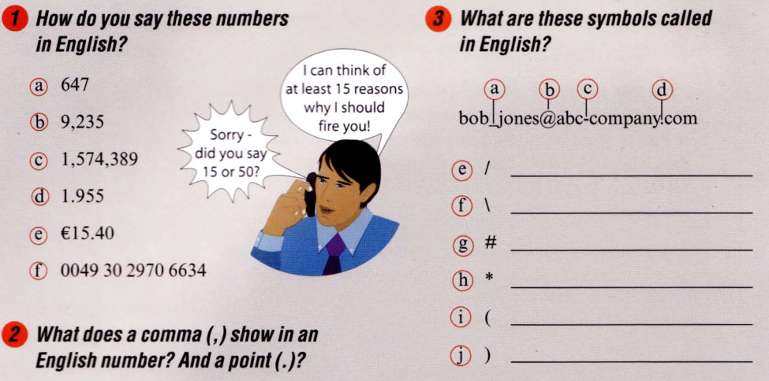
Unit 2: Could you spell that for me?

Slide 3
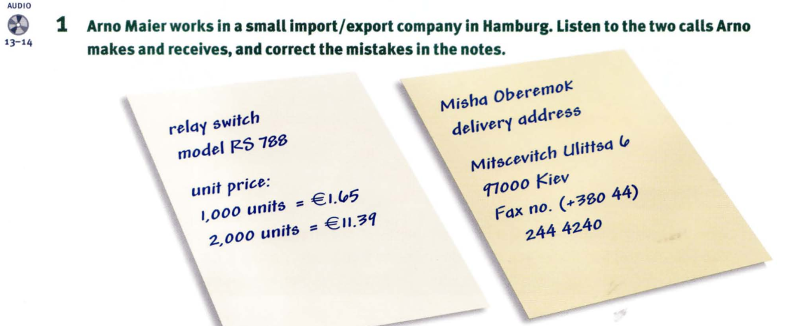

Slide 4
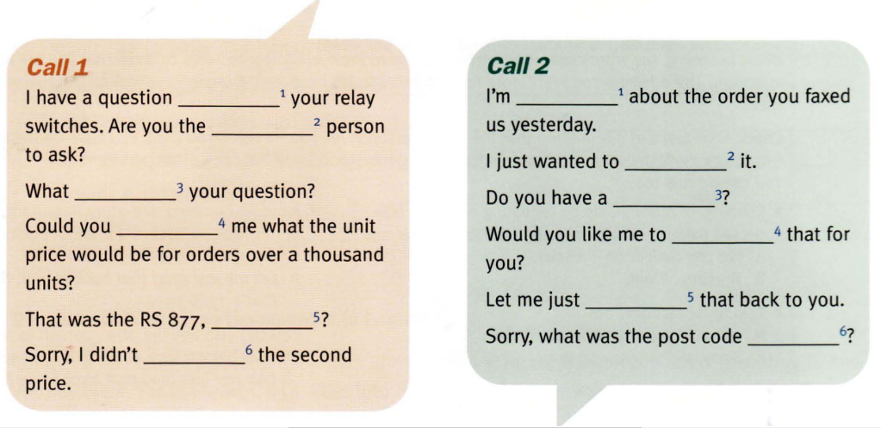
2. Listen to the dialogues again and complete the sentences and questions below.

Slide 5
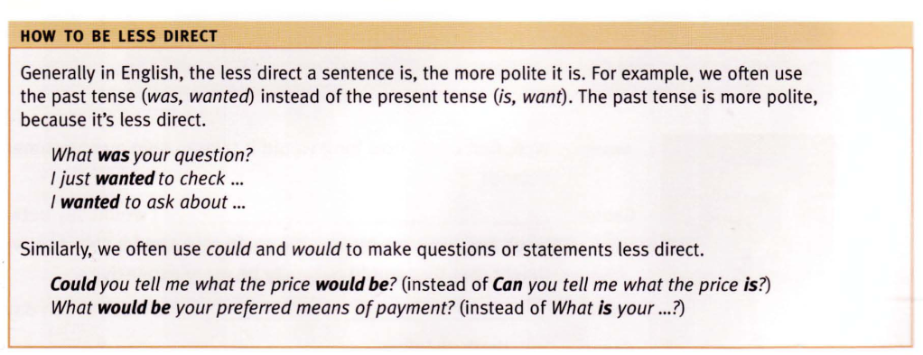

Slide 6
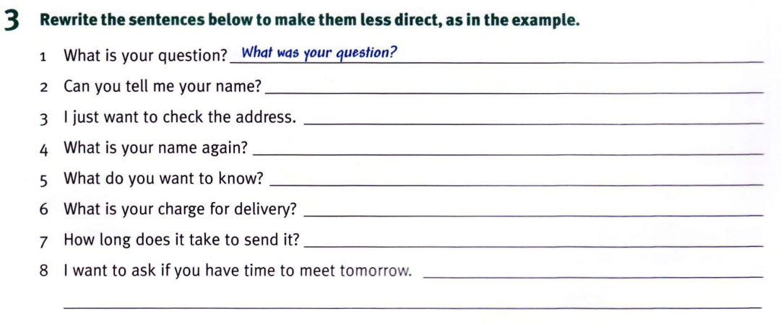

Slide 7
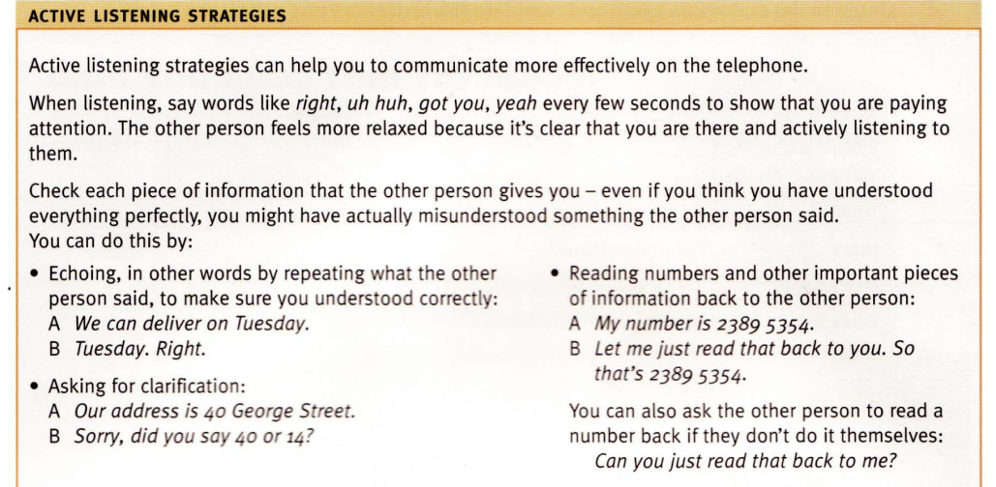

Slide 8
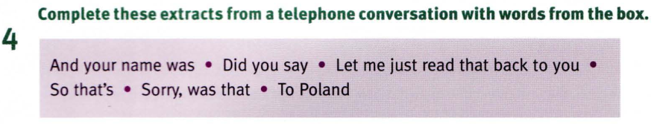
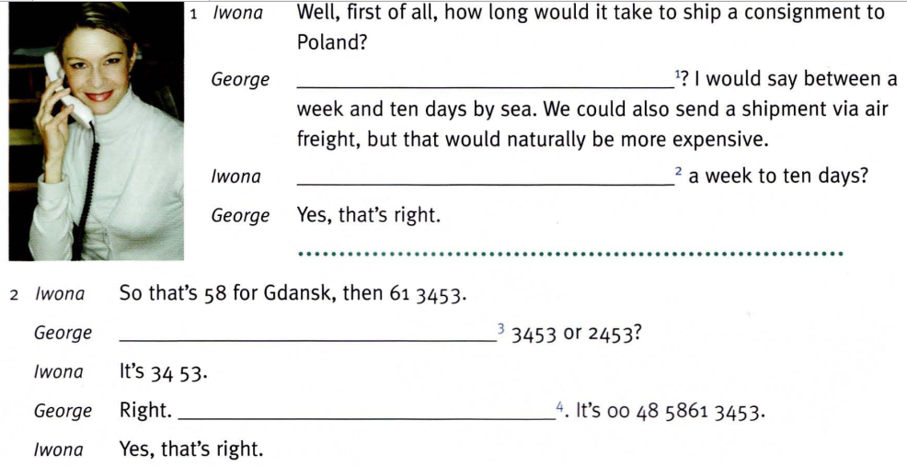

Slide 9
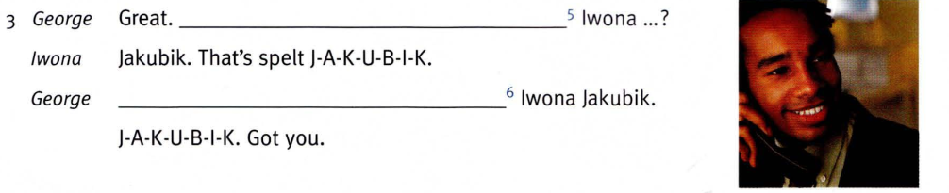

Slide 10
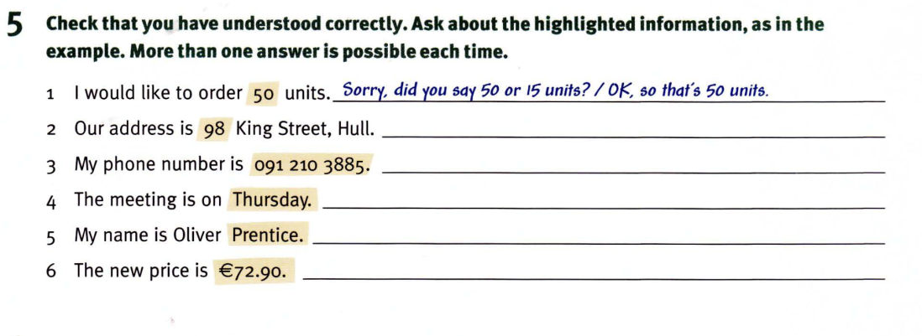

Slide 11
Homework:
After these two periods you have to remember vocabulary part ‘Active listening strategies’ and part 5.
Students do exercises 5
Students read the tips.
Prepare for unit 2: Could you spell that for me? (cont.)

